Slide 1

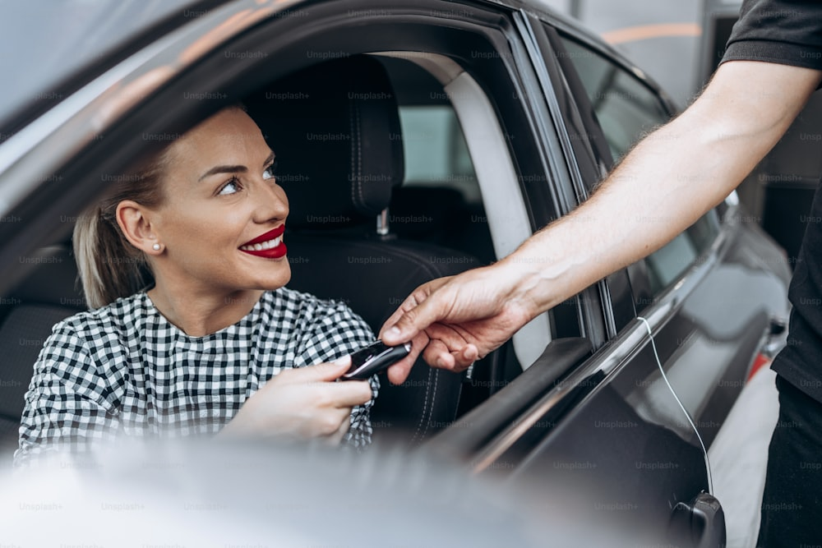
Car Rental System
Tushar Kumar
2200290140163

Slide 2
INTRODUCTION
Welcome to our presentation on the Car Rental System project. Our objective is to develop an innovative and user-friendly platform that revolutionizes the way people rent vehicles. With a focus on convenience, efficiency, and reliability, our system will offer features such as online booking, fleet management, user profiles, secure payment integration, and dedicated customer support. Through this project, we aim to provide customers with convenient access to a diverse range of vehicles, competitive pricing, and a seamless rental experience. Our vision is to set new standards in the car rental industry by prioritizing customer satisfaction, innovation, and sustainability. Thank you for joining us on this journey towards redefining transportation solutions.

Slide 3



Technologies Used
Frontend
Backend
Database
ReactJS
NodeJS, ExpressJS
MongoDB

Slide 4
BENEFITS
Convenience: Our system offers unparalleled convenience, allowing users to browse and book vehicles online from anywhere at any time. This eliminates the need for physical visits to rental agencies, saving time and effort.
Cost-Effectiveness: By providing transparent pricing and competitive rates, our system ensures cost-effective transportation solutions for customers. Additionally, efficient fleet management helps optimize operational costs, which can be passed on to the end-users.
Accessibility: Catering to the needs of a diverse customer base, our system offers accessibility to a wide range of vehicles, from compact cars to luxury vehicles, suitable for various purposes and preferences.

Slide 5
Modules
Home page
Car List
Payment
Admin page
Where user will first land.
All the available cars.
Where you can pay for car.
Admin add or delete the cars.

Slide 6
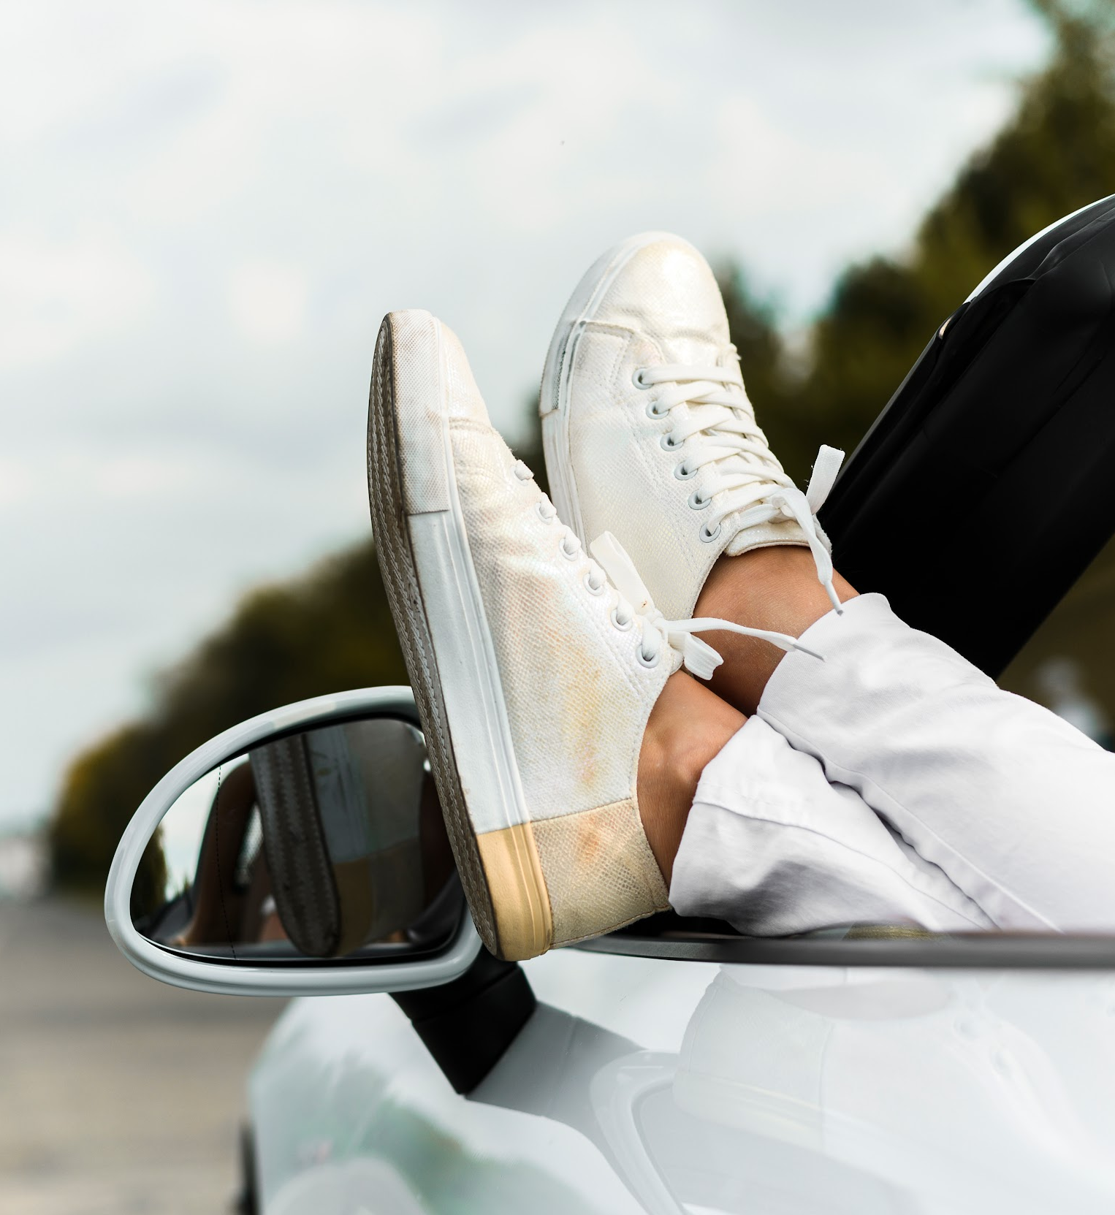
Thanks!

Slide 7
CONCLUSION
In conclusion, our Car Rental System project offers convenience, cost-effectiveness, and reliability to users. With a focus on accessibility, efficiency, and sustainability, we're reshaping the future of transportation. Join us in driving towards a smarter, greener, and more connected world. Thank you for your attention and support. Let's make transportation easier, together.

